Slide 1
Using NEAT to play Sonic The Hedgehog 2
By Axyl Fredrick

Slide 2
How does NEAT work?

Slide 3
NeuroEvolution of Augmenting Topologies (NEAT)
Algorithm for optimizing weights and network connections.
NEAT evolves the architecture and topology, not just the weights.
Maintains diversity through speciation.

Slide 4
Genetic Encoding
Adds new genes to population and sensibly mates such that there are diverse topologies.
The population is divided into species, and explicit fitness sharing is used to prevent a species from becoming too big.

Slide 5
NEAT is neat!
Unlike other learning algorithms, NEAT learns the weight values on its own.
Every connection is encoded, and the best survive.
NEAT optimizes and complexifies solutions (Stanley 124)!
Gene alignment to allow species to reproduce.

Slide 6

Imagine a population of monkeys typing out a novel
Source: https://commons.wikimedia.org/wiki/File:Typing_monkey_Color768px.png
Notes:
Each monkey has an ID associated with him

Slide 7
The best survive, identified and rewarded
Source: https://commons.wikimedia.org/wiki/File:Typing_monkey_Color768px.png

Slide 8
New monkeys are born, and the intermediate monkeys kept
Source: https://commons.wikimedia.org/wiki/File:Typing_monkey_Color768px.png

Slide 9
What did I use?
Neat Python Library (with a Recurrent Network because recurrent networks looks at the past).
Gym Retro (OpenAI library for converting game to Python environment)
OpenCV (for the network to train on visual data)
For visuals:
GraphViz and Matplotlib

Slide 10
The Game Itself

Slide 11
Why Sonic 2?
Much more complex than other games like Snake.
Accessible game.
Good metrics for level progress (e.g. how far to the right Sonic is, rings, score)
No infinite loops because time overs (death after 10 min) exist.
The physics engine is interesting for a model to go through.

Slide 12
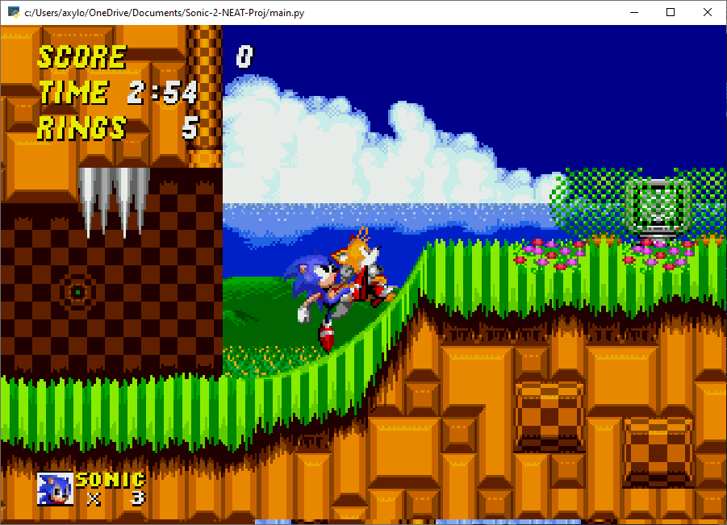
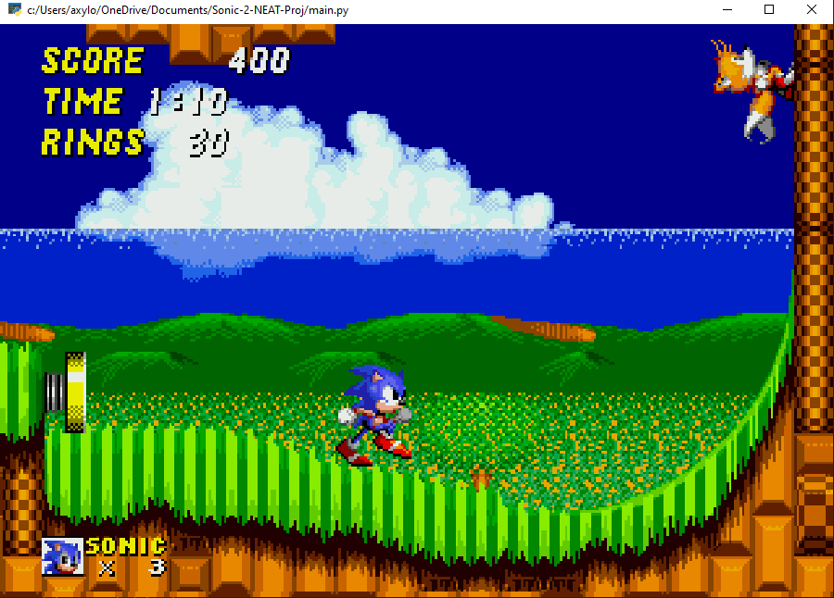
Sonic gets stuck! Soft lock!

Slide 13
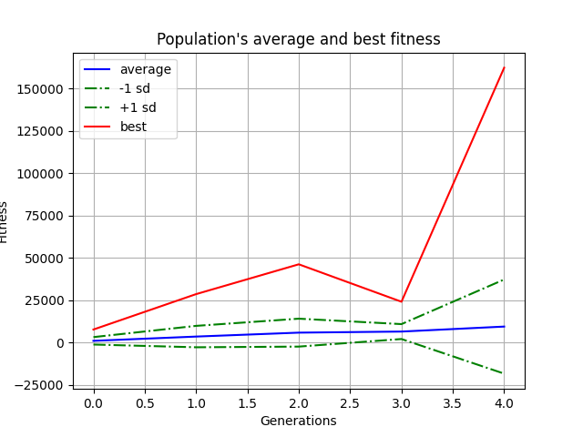
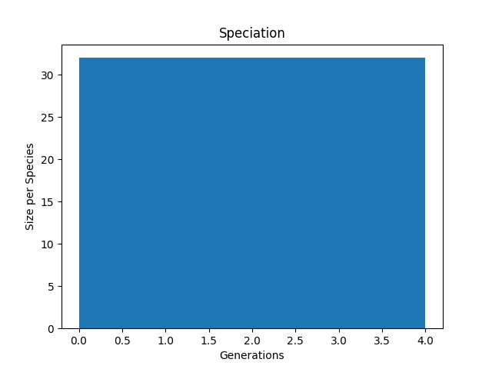
Charts from one run of Emerald Hill Zone 1

Slide 14
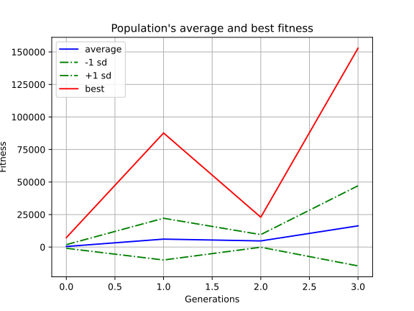
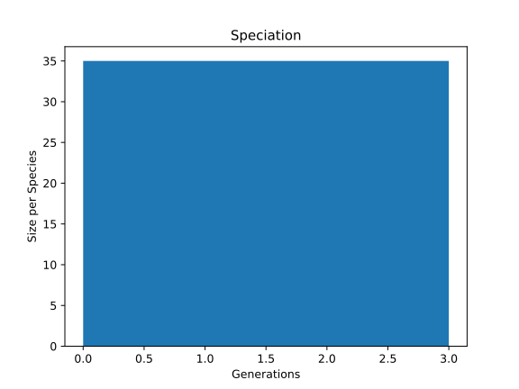
Charts from another run of Emerald Hill Zone 1

Slide 15
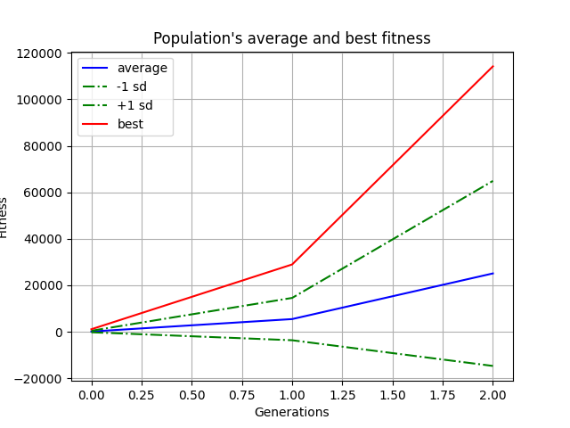

Charts from one run of Chemical Plant Zone 2

Slide 16
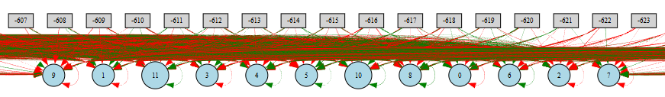
What does this neural net look like?
1120 inputs, and 12 outputs.

Slide 17
Why 1120 inputs?
320 x 224 is the resolution of the Genesis.
We split each piece into eighths, so we look at 40 x 28 chunks.
That is about the size of 1 Sonic, which makes it convenient.
40 chunks x 28 chunks = 1120 chunks

Slide 18
What the model “sees”

Slide 19
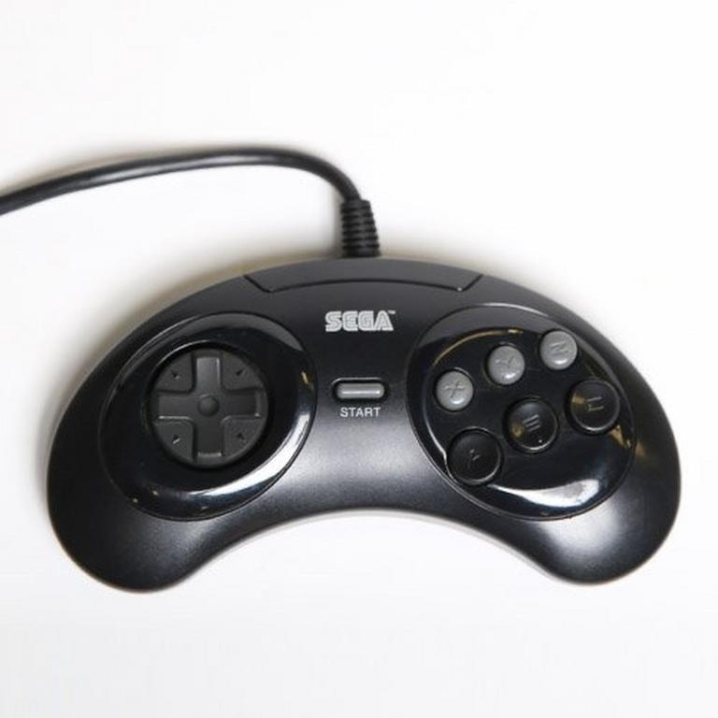
Why 12 outputs?
There are 4 D-pad buttons, 6 face buttons (X, Y, Z, A, B, C), 1 start button, and 1 mode button (some inputs are for the 6 button controller only).

Slide 20
Conclusion
Pros:
Produces a robust model from previous models.
Refines itself to be a better neural network and corrects its own mistakes.
Cons:
Takes a long time to train for an optimal run, as it has the best of each segment. Doesn’t try to max out for all in one go.

